Slide 1
Stable Diffusion Data Augmentation
Eduard-Mitruț Roșca
Albert Reguș

Slide 2
Problem: Data-Hungry Models
MODERN MACHINE LEARNING MODELS DEMAND ENORMOUS DATASETS FOR TRAINING
DATA COLLECTION, LABELING, AND PREPROCESSING ARE COSTLY AND TIME-INTENSIVE

Slide 3
Solution: Leveraging Stable Diffusion & ControlNet
Use Stable Diffusion to generate realistic synthetic data.
Employ ControlNet for controlled and diverse image synthesis.
Focus application: generating varied traffic images.

Slide 4
Dataset Integration
COMBINED 4 DISTINCT TRAFFIC DATASETS FOR CONSISTENCY.
DATASETS WERE PROCESSED TO ENSURE UNIFORM STYLE.
AUGMENTED SYNTHETIC IMAGES WITH DEPTH LAYERS GENERATED USING MIDAS FOR ENHANCED TRAINING QUALITY.

Slide 5
Comparison of Models
1: Segmentation mask only
2: Depth map only
3: Segmentation mask + Depth map
We used FID (Fréchet inception distance) to compare models before doing the final training
(Lower is better)

Slide 6
Comparison of Models
1: Segmentation mask only
583.269.568 Parameters
~ 39 seconds Inference time¹
2: Depth map only
583.258.048 Parameters
~ 31 seconds Inference time¹
3: Segmentation mask + Depth map
583.275.328 Parameters
~ 32 seconds Inference time¹
1. Setup used: L40S GPU (362TFLOPs), 16 CPU Cores, 48Gb RAM

Slide 7
Final model
(Lower is better)

Slide 8
Demo: Image Showcase
Generated synthetic traffic scenarios using Stable Diffusion and ControlNet.

Slide 9
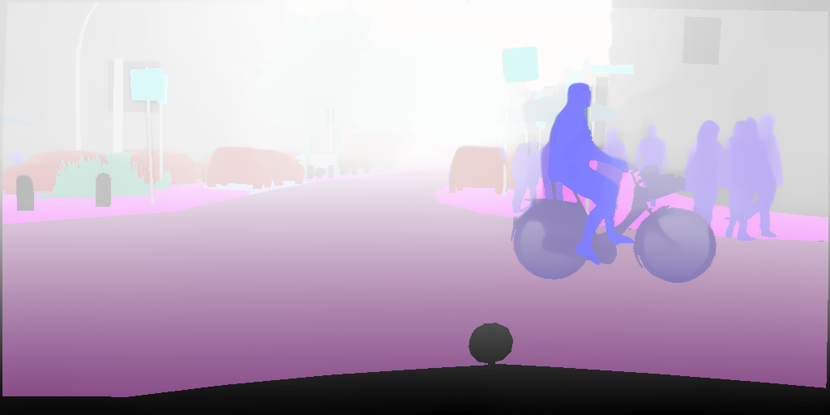
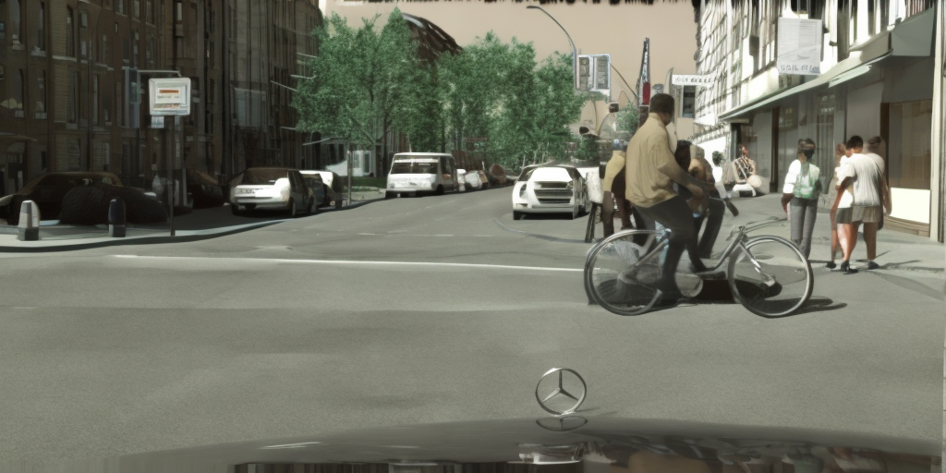
Demo: Image Showcase
Input
Output

Slide 10
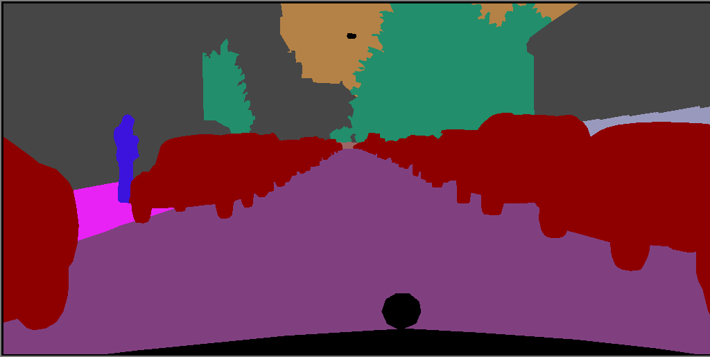
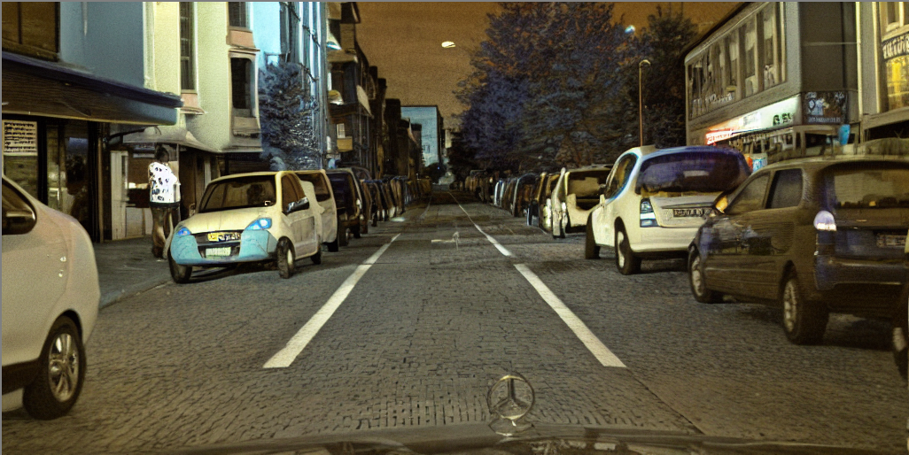
Demo: Image Showcase
Input
Output

Slide 11
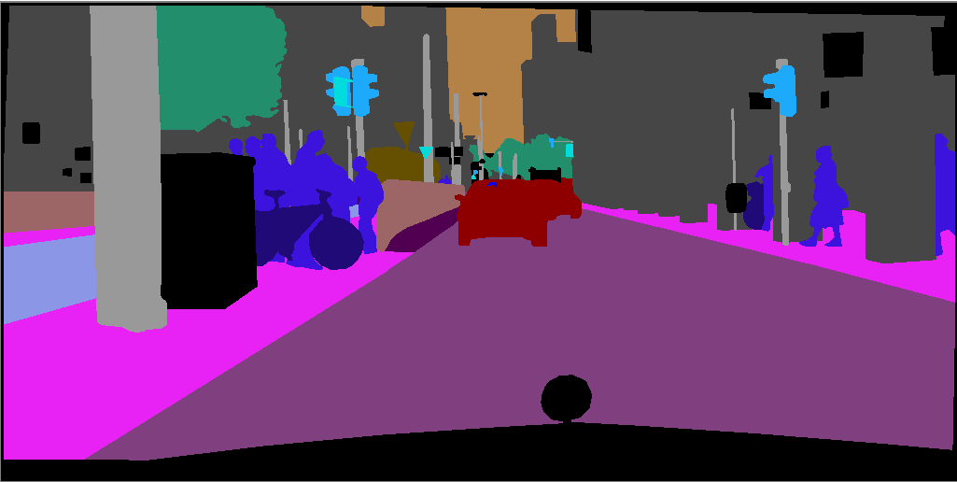
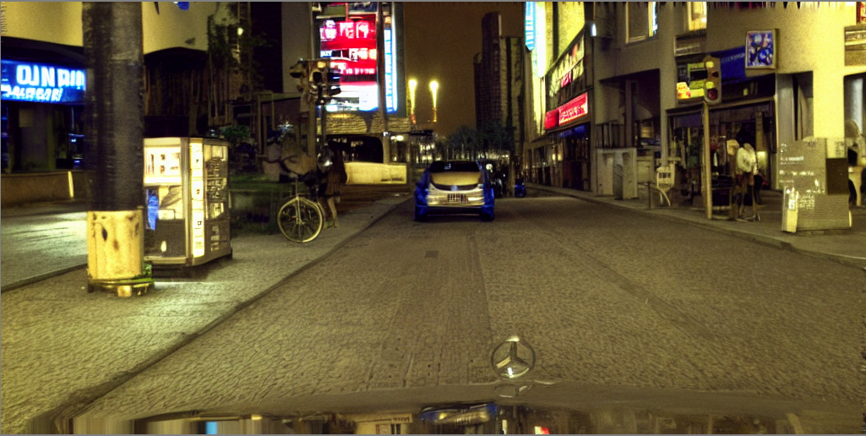
Demo: Image Showcase
Input
Output

Slide 12
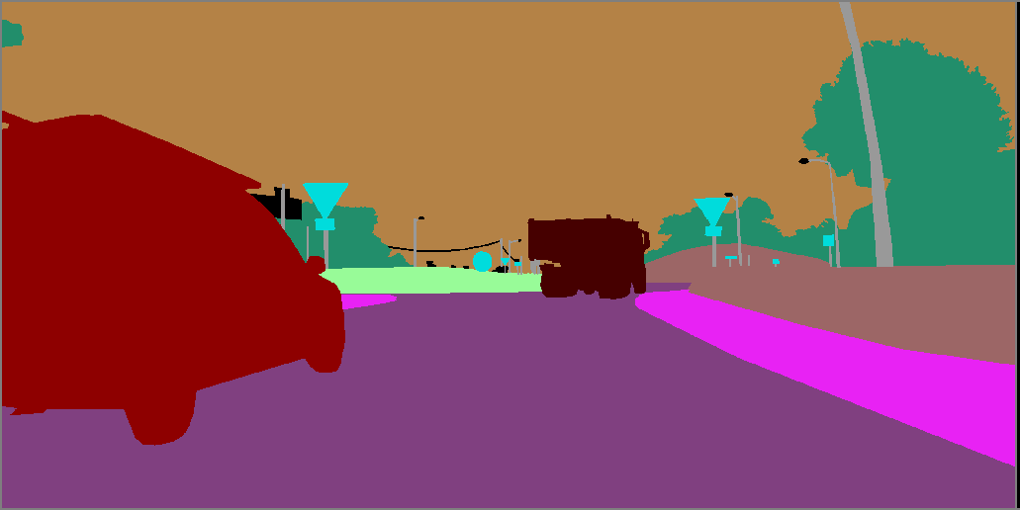
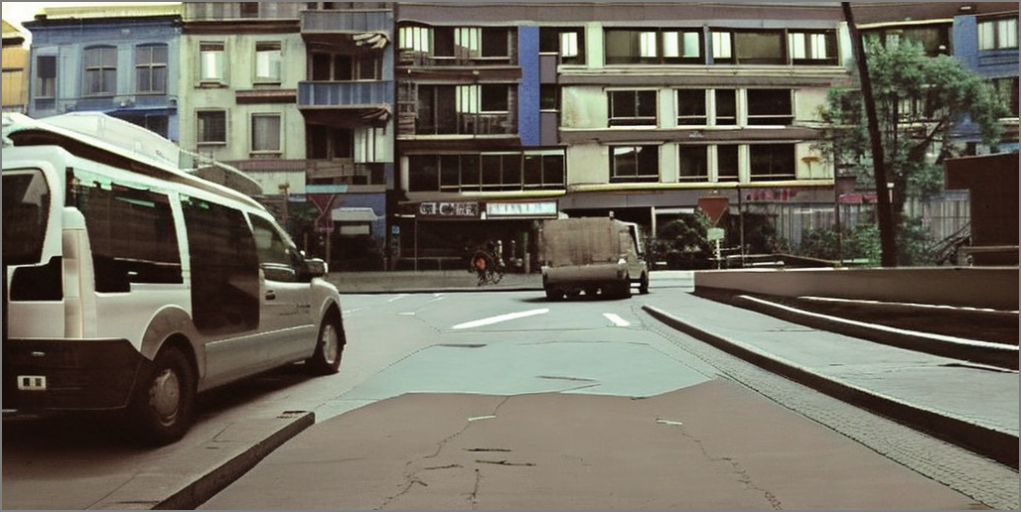
Demo: Image Showcase
Input
Output

